Slide 1
Air Bags on the Moon
Shawn Wortham
&
Alex Dragoo

Slide 2
Our Design
We decided to stay away from the inflatable airbag idea and be more creative. Our design was “shock absorbent shells.”
We placed the egg inside a box and surrounded it with crumpled newspaper. We then placed that box inside a larger box and put more crumpled newspaper in between those boxes. This process was repeated once more.
The thought behind this idea was that the air pockets in the crumpled newspaper would increase the time over which the force of the box hitting the ground is applied. This will hopefully leave our egg intact after the fall.
This design brought about two problems. The newspaper and box combination increased the mass of the system greatly. This design may also be troublesome to enact on a larger scale.

Slide 3
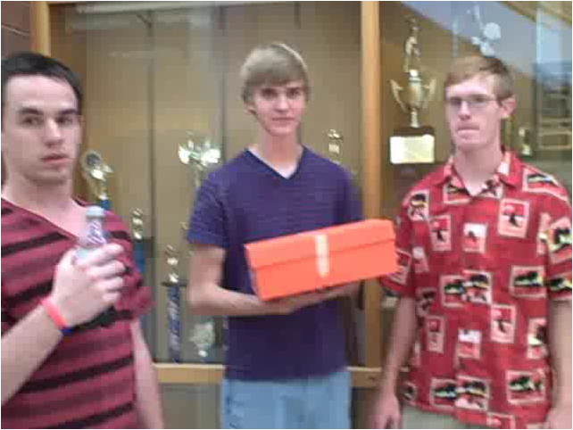
Pre-drop Interview
Click here for video

Slide 4
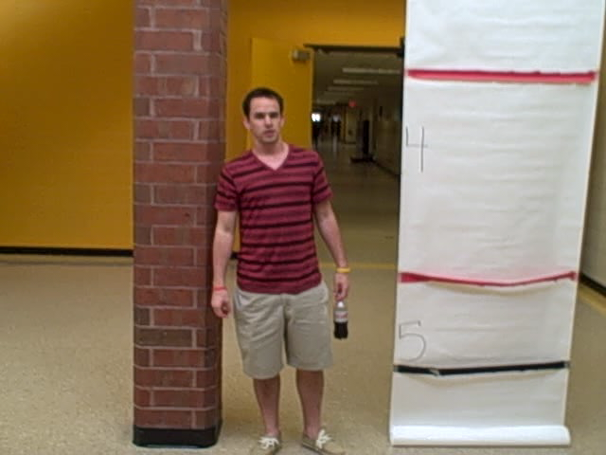
Egg Drop
Click here for video

Slide 5
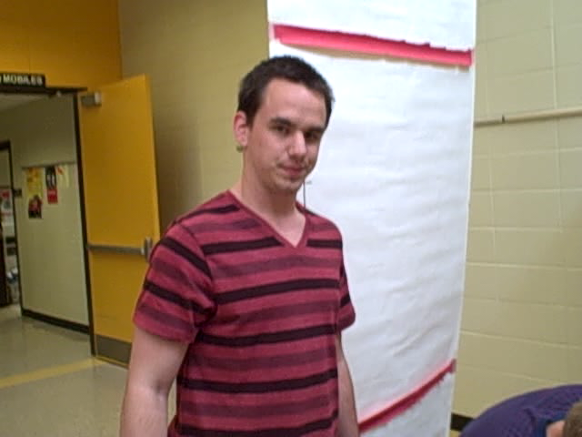
Result
Click here for video

Slide 6
Analysis
From the video we determined that the box is in contact with the ground for only .34 seconds. We were trying to increase the amount of time over which the force was applied but our design failed to increase that time substantially. The weight of the box was also so great that the force of the box hitting the ground was very high. In order to counteract this force we need it to be applied for a much greater period of time.

Slide 7
Changes/Modification
Egg drop was unsuccessful, so modifications must be made.
- The box was weighted too heavily for a successful drop due to the many boxes used that we thought would be helpful for cushion. The momentum is proportional to the weight.
- If we used more newspaper, and less boxes, we think that the time of impact would be increased, which would increase the chances of keeping the egg intact.
- We could also use a better material other than newspaper to increase the amount of air pockets which in turn would increase the time of impact.

