Slide 1
Brian’s Cannon Adventure
By: Shawn Wortham, Alex Dragoo,
and Jacob Buice

Slide 2
The Settings
V_{initial} -17m/s
Angle- 45 degrees
Cannon height- 3 meters

Slide 3
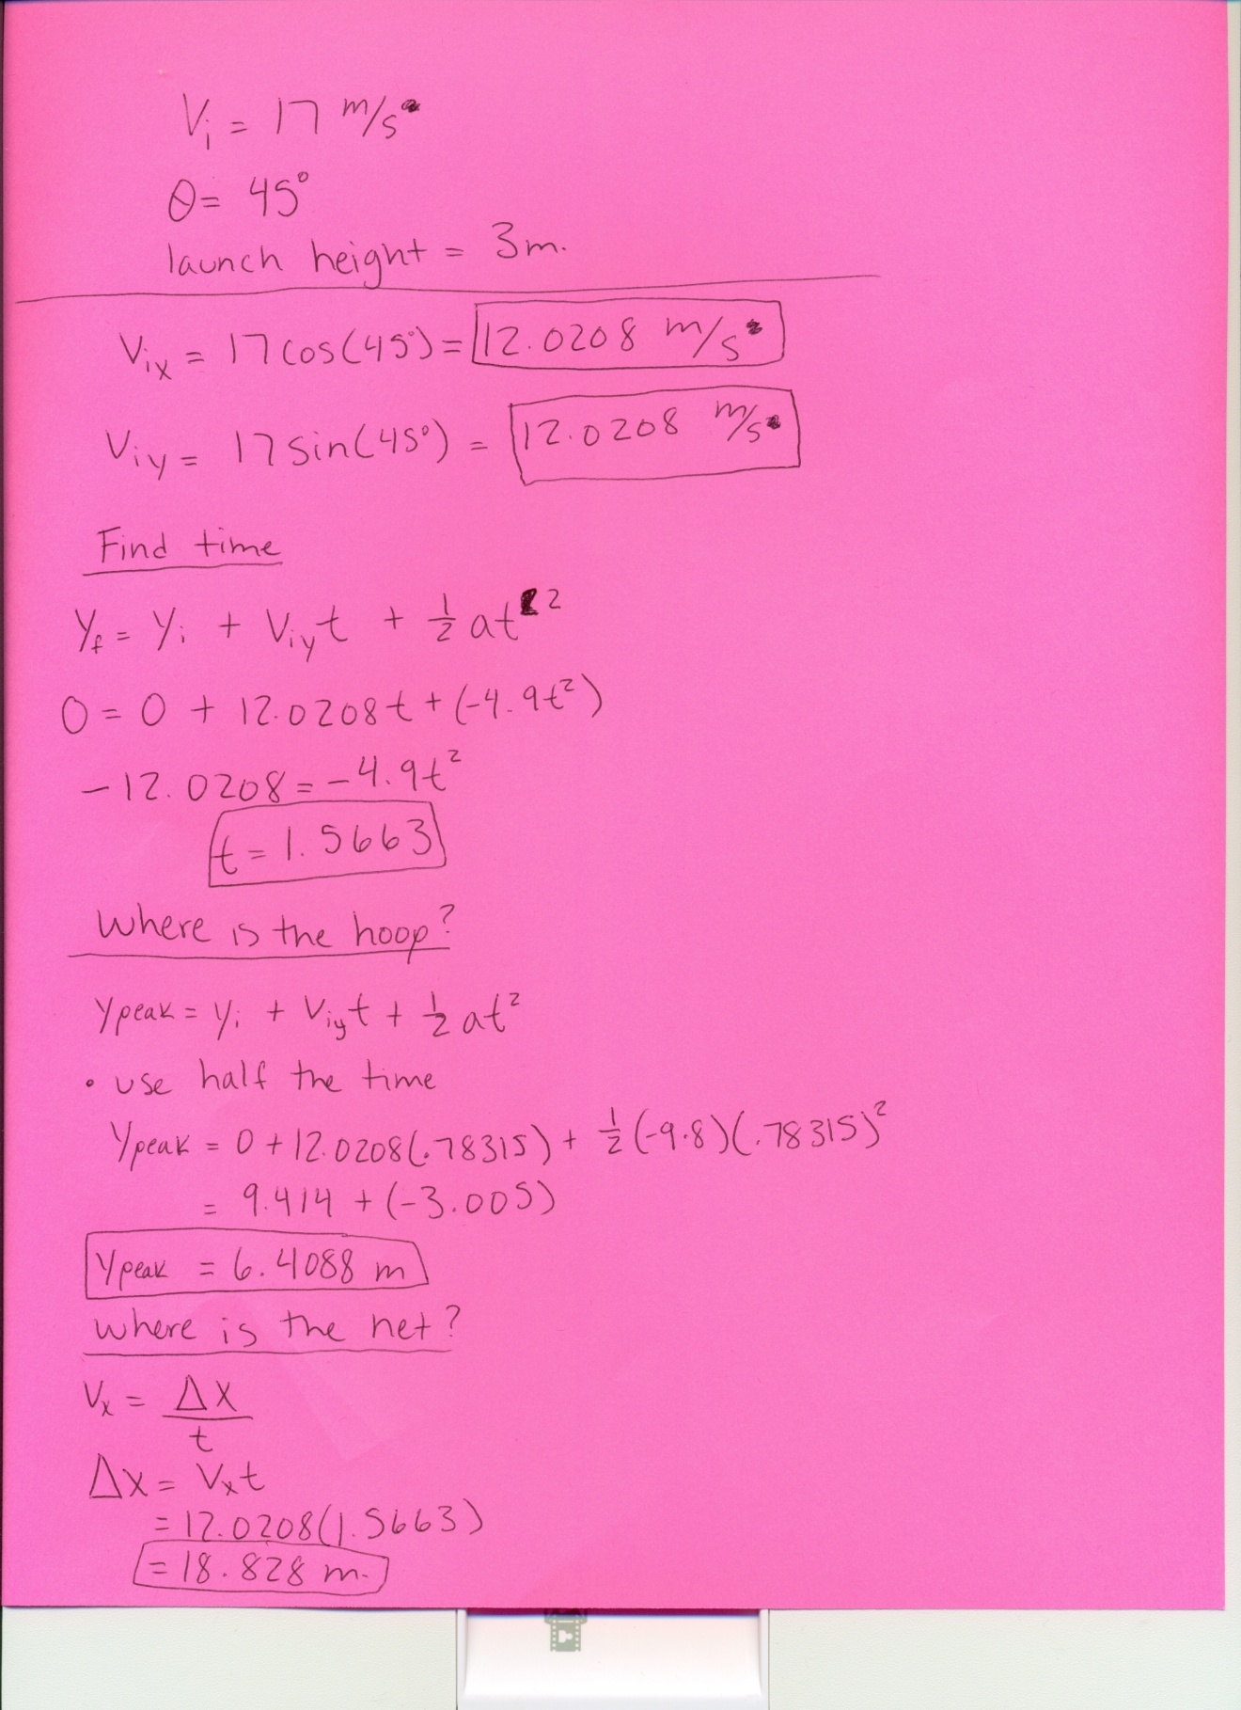
Calculations

Slide 4
Our Cannon Ball Stunt
Our human cannon ball stunt is by far the most entertaining of all time. Our cannon is 3 meters high, and the net to catch Brian is the same height. Brian gets shot out of the cannon at the blazing speed of 17 meters per second. He reaches the ring of deadly pythons 9.414 meters away approximately .78315 seconds. Brian goes through the ring at the peak of his trajectory which is at 6.4088 meters. If he makes it through the pythons he will land in the net 9.414 meters away fro the ring in .78315 seconds as well. Overall He will spend 1.5663 seconds in the air! The entire time he is over a giant man eating shark. This will be an extremely crazy, death defying stunt that is great for the whole family!

Slide 5
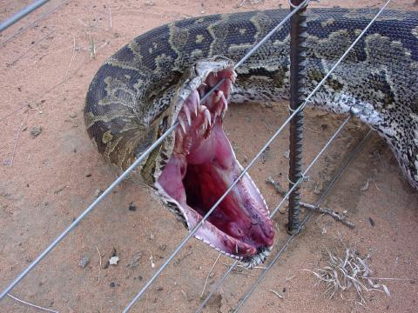
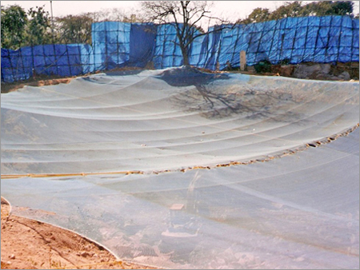
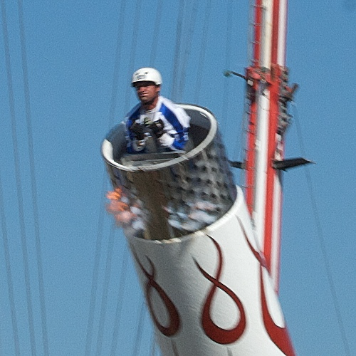
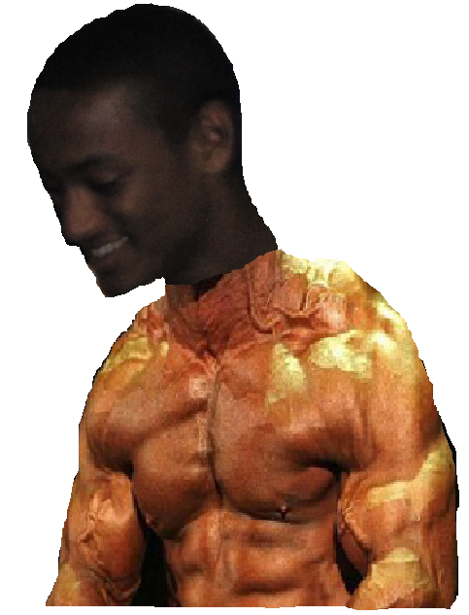
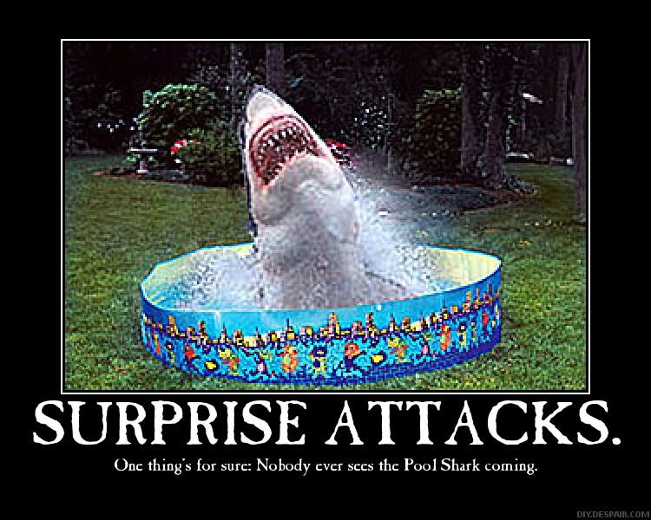
Cannon Testing

